Slide 1
Chapter 4
How to develop a data-driven MVC web app

Slide 2
Objectives (part 1)
Applied
Given the specifications for a multi-page web app that stores data in a database, code and test the app.
Use Visual Studio to add the NuGet packages for EF Core and its tools to a project.
Knowledge
Describe how you can code a primary key for an entity by convention and describe when the value for that primary key will be automatically generated.
Describe how a DB context class maps related entity classes to a database and seeds the database with initial data.
Name the file that’s typically used to store a connection string for a database.

Slide 3
Objectives (part 2)
Describe how a Startup.cs file can read a connection string from a file.
Describe how ASP.NET Core uses dependency injection to pass DbContext objects to the controllers that need them.
Describe how to use the Package Manager Console to create migration files and use them to create and update the database of a web app.
Describe how to use LINQ to query the data that’s available from the DbSet properties of a DbContext object.
Describe how to use the methods of the DbSet and DbContext classes to add, update, or delete entities in the database.
Describe how you can code a foreign key for an entity by convention.

Slide 4
Objectives (part 3)
Describe how to use the Startup.cs file to modify the HTTP request and response pipeline to provide for user-friendly URLs.
Describe how slugs can make URLs more user friendly.

Slide 5
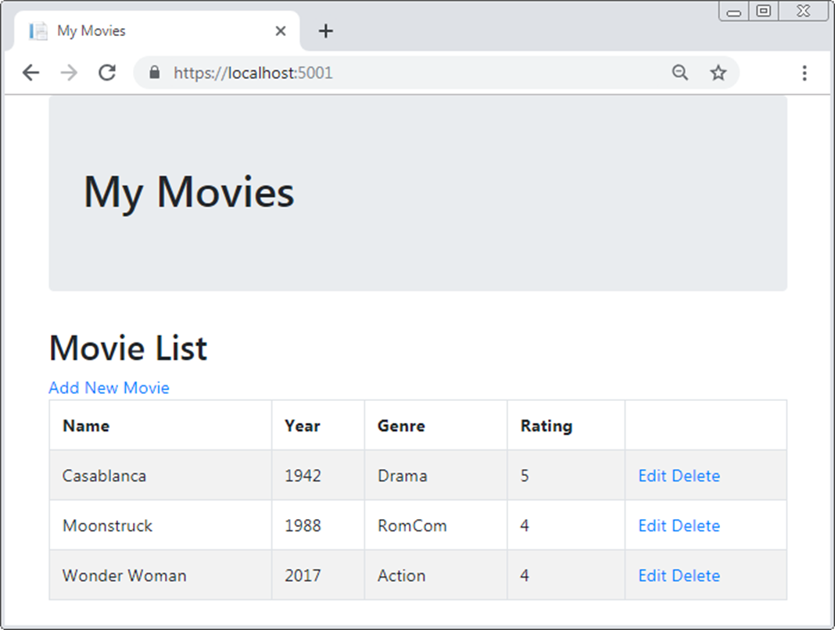
The Movie List page of the Movie List app

Slide 6
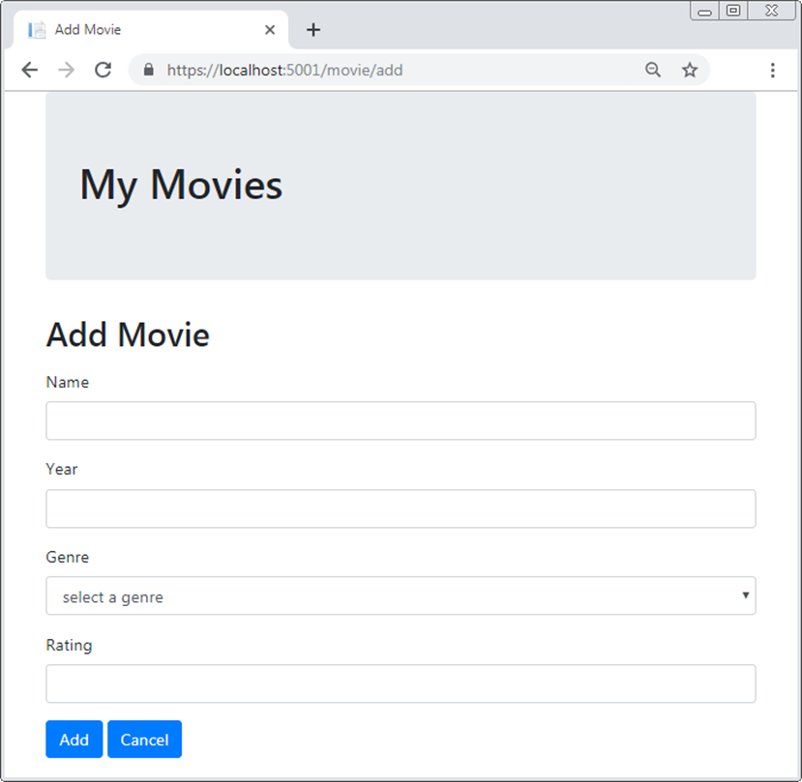
The Add Movie page of the Movie List app

Slide 7
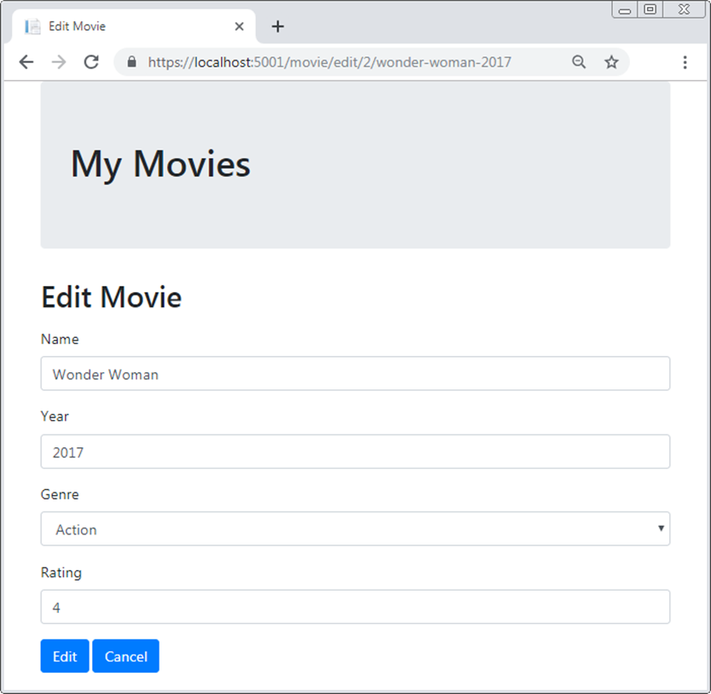
The Edit Movie page of the Movie List app

Slide 8
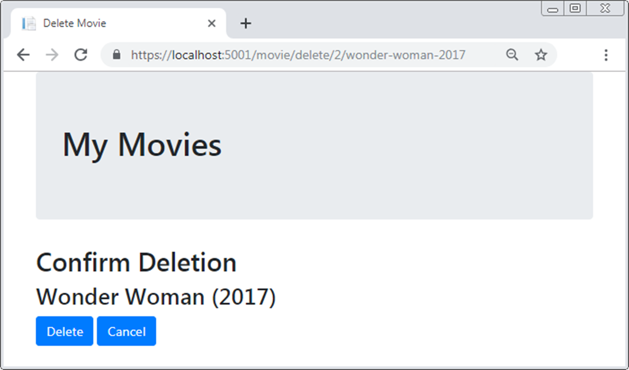
The Confirm Deletion page of the Movie List app

Slide 9
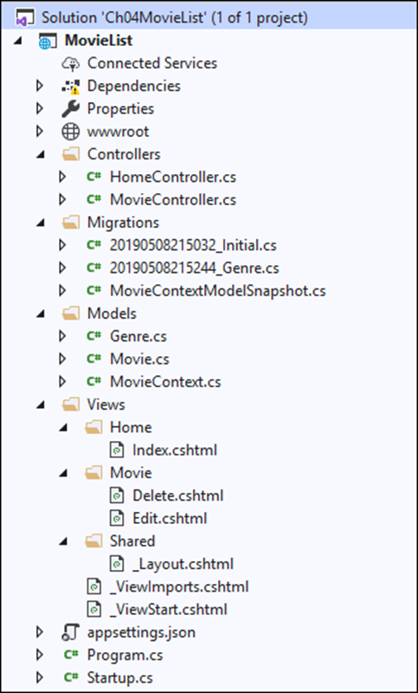
The Solution Explorer for the Movie List app

Slide 10
Folders in the Movie List app
Models
Views
Controllers
Migrations
Files in the Movie List app
appsettings.json
Startup.cs

Slide 11
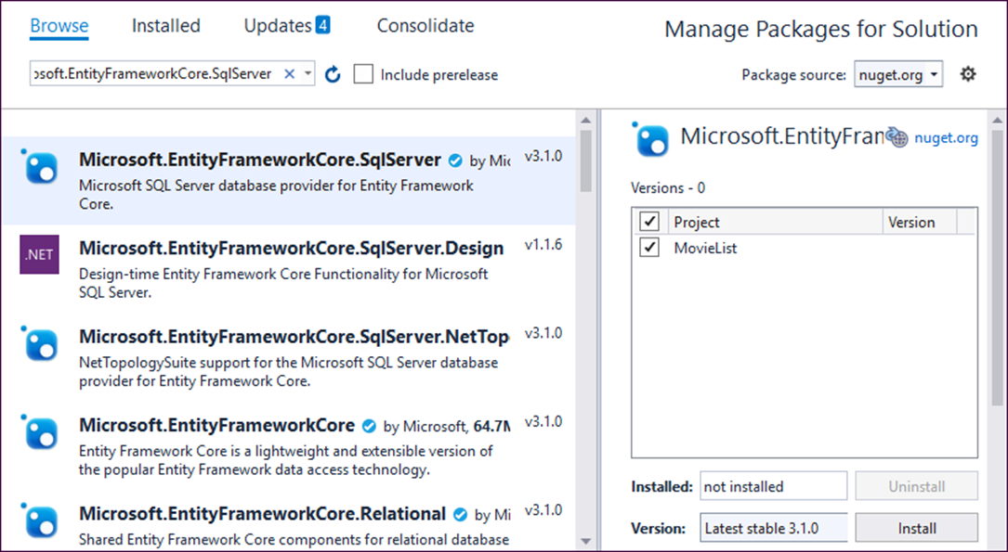
How to open the NuGet Package Manager
Select Tools→Nuget Package Manager→Manage NuGet Packages for Solution.
The NuGet Package Manager

Slide 12
How to install the NuGet packages for EF Core
Click the Browse link in the upper left of the window.
Type “Microsoft.EntityFrameworkCore.SqlServer” in the search box.
Click on the appropriate package from the list that appears in the left-hand panel.
In the right-hand panel, check the project name, select the version that matches the version of .NET Core you’re running, and click Install.
Review the Preview Changes dialog that comes up and click OK.
Review the License Acceptance dialog that comes up and click I Accept.
Type “Microsoft.EntityFrameworkCore.Tools” in the search box.
Repeat steps 3 through 6.

Slide 13
Three classes provided by EF Core
DbContext
DbContextOptions
DbSet<Entity>

Slide 14
A MovieContext class that inherits the DbContext class
using Microsoft.EntityFrameworkCore;
namespace MovieList.Models
{
public class MovieContext : DbContext
{
public MovieContext(DbContextOptions<MovieContext> options)
: base(options)
{ }
public DbSet<Movie> Movies { get; set; }
}
}

Slide 15
A Movie class with a property whose value is generated by the database
using System.ComponentModel.DataAnnotations;
namespace MovieList.Models
{
public class Movie
{
// EF Core will configure the database to generate this value
public int MovieId { get; set; }
[Required(ErrorMessage = "Please enter a name.")]
public string Name { get; set; }
[Required(ErrorMessage = "Please enter a year.")]
[Range(1889, 2999, ErrorMessage = "Year must be after 1889.")]
public int? Year { get; set; }
[Required(ErrorMessage = "Please enter a rating.")]
[Range(1, 5, ErrorMessage =
"Rating must be between 1 and 5.")]
public int? Rating { get; set; }
}
}

Slide 16
One method of the DbContext class
OnModelCreating(mb)

Slide 17
A MovieContext class that seeds initial Movie data (part 1)
namespace MovieList.Models
{
public class MovieContext : DbContext
{
public MovieContext(DbContextOptions<MovieContext> options)
: base(options)
{ }
public DbSet<Movie> Movies { get; set; }
protected override void OnModelCreating(
ModelBuilder modelBuilder)
{
modelBuilder.Entity<Movie>().HasData(
new Movie {
MovieId = 1,
Name = "Casablanca",
Year = 1942,
Rating = 5
},

Slide 18
A MovieContext class that seeds initial Movie data (part 2)
new Movie {
MovieId = 2,
Name = "Wonder Woman",
Year = 2017,
Rating = 3
},
new Movie {
MovieId = 3,
Name = "Moonstruck",
Year = 1988,
Rating = 4
}
);
}
}
}

Slide 19
A connection string in the appsettings.json file
{
"Logging": {
"LogLevel": {
"Default": "Warning"
}
},
"AllowedHosts": "*",
"ConnectionStrings": {
"MovieContext": "Server=(localdb)\\mssqllocaldb;Database=Movies;
Trusted_Connection=True;MultipleActiveResultSets=true"
}
}

Slide 20
Code that enables dependency injection for DbContext objects
using Microsoft.Extensions.Hosting;
using Microsoft.EntityFrameworkCore;
using MovieList.Models;
...
public class Startup
{
public Startup(IConfiguration configuration)
{
Configuration = configuration;
}
public IConfiguration Configuration { get; }
public void ConfigureServices(IServiceCollection services)
{
...
services.AddDbContext<MovieContext>(options =>
options.UseSqlServer(
Configuration.GetConnectionString("MovieContext")));
}
...
}

Slide 21
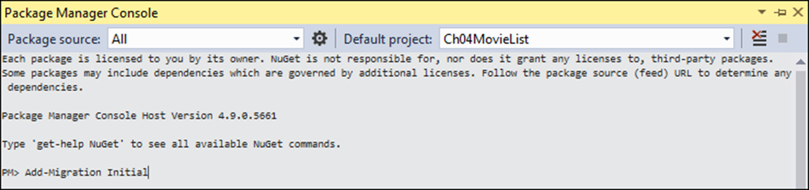
The Package Manager Console (PMC) window
How to open the PMC window
Select the Tools→NuGet Package Manager→Package Manager Console command.

Slide 22
How to create the Movies database from your code
Make sure the connection string and dependency injection are set up.
Type “Add-Migration Initial” in the PMC at the command prompt and press Enter.
Type “Update-Database” at the command prompt and press Enter.

Slide 23
The Up() method of the Initial migration file
protected override void Up(MigrationBuilder migrationBuilder)
{
migrationBuilder.CreateTable(
name: "Movies",
columns: table => new {
MovieId = table.Column<int>(nullable: false)
.Annotation("SqlServer:ValueGenerationStrategy",
SqlServerValueGenerationStrategy.IdentityColumn),
Name = table.Column<string>(nullable: false),
Year = table.Column<int>(nullable: false),
Rating = table.Column<int>(nullable: false)
},
constraints: table => {
table.PrimaryKey("PK_Movies", x => x.MovieId);
});
migrationBuilder.InsertData(
table: "Movies",
columns: new[] { "MovieId", "Name", "Rating", "Year" },
values: new object[] { 1, "Casablanca", 5, 1942 });
// code that inserts the other two movies
}

Slide 24
How to view the database once it’s created
Choose the View→SQL Server Object Explorer command in Visual Studio.
Expand the (localdb)\MSSQLLocalDB node, then expand the Databases node.
Expand the Movies node, then expand the Tables node.
To view the table columns, expand a table node and then its Columns node.
To view the table data, right-click a table and select the ViewData command.

Slide 25
LINQ methods that build or execute a query expression
Where(lambda)
OrderBy(lambda)
FirstOrDefault(lambda)
ToList()
A method of the DbSet<Entity> class that gets an entity by its id
Find(id)

Slide 26
A using directive that imports the LINQ namespace
using System.Linq;
A DbContext property that’s used in the examples
private MovieContext context { get; set; }
Code that builds a query expression
IQueryable<Movie> query =
context.Movies.OrderBy(m => m.Name);
Code that executes a query expression
List<Movie> movies = query.ToList();
Code that builds and executes a query expression
var movies =
context.Movies.OrderBy(m => m.Name).ToList();

Slide 27
Code that builds a query expression by chaining LINQ methods
var query = context.Movies.Where(m => m.Rating > 3)
.OrderBy(m => m.Name);

Slide 28
Code that builds a query expression on multiple lines
IQueryable<Movie> query = context.Movies;
query = query.Where(m => m.Year > 1970);
query = query.Where(m => m.Rating > 3);
query = query.OrderBy(m => m.Name);

Slide 29
Three ways to select a movie by its id
int id = 1;
var movie = context.Movies.Where(
m => m.MovieId == id).FirstOrDefault();
var movie = context.Movies.FirstOrDefault(m => m.MovieId == id);
var movie = context.Movies.Find(id);

Slide 30
Three methods of the DbSet class
Add(entity)
Update(entity)
Remove(entity)
One method of the DbContext class
SaveChanges()
A using directive for the EF Core namespace
using Microsoft.EntityFrameworkCore;

Slide 31
Code that adds a new movie to the database
var movie = new Movie { Name = "Taxi Driver",
Year = 1976,
Rating = 4
};
context.Movies.Add(movie);
context.SaveChanges();

Slide 32
An appsettings.json file that displays the generated SQL statements
{
"Logging": {
"LogLevel": {
"Default": "Information",
"Microsoft": "Warning",
"Microsoft.Hosting.Lifetime": "Information",
"Microsoft.EntityFrameworkCore.Database.Command": "Debug"
}
...
}

Slide 33
Code that selects movies from the database
var movies = context.Movies.OrderBy(m => m.Name).ToList();
The generated SQL statement
SELECT [m].[MovieId], [m].[Name], [m].[Rating], [m].[Year]
FROM [Movies] AS [m]
ORDER BY [m].[Name]

Slide 34
The Home controller
using System.Linq;
using Microsoft.AspNetCore.Mvc;
using MovieList.Models;
namespace MovieList.Controllers
{
public class HomeController : Controller
{
private MovieContext context { get; set; }
public HomeController(MovieContext ctx) {
context = ctx;
}
public IActionResult Index() {
var movies = context.Movies.OrderBy(
m => m.Name).ToList();
return View(movies);
}
}
}

Slide 35
The Home/Index view (part 1)
@model List<Movie>
@{
ViewBag.Title = "My Movies";
}
<h2>Movie List</h2>
<a asp-controller="Movie" asp-action="Add">Add New Movie</a>
<table class="table table-bordered table-striped">
<thead>
<tr>
<th>Name</th>
<th>Year</th>
<th>Rating</th>
<th></th>
</tr>
</thead>

Slide 36
The Home/Index view (part 2)
<tbody>
@foreach (var movie in Model) {
<tr>
<td>@movie.Name</td>
<td>@movie.Year</td>
<td>@movie.Rating</td>
<td>
<a asp-controller="Movie" asp-action="Edit"
asp-route-id="@movie.MovieId">Edit</a>
<a asp-controller="Movie" asp-action="Delete"
asp-route-id="@movie.MovieId">Delete</a>
</td>
</tr>
}
</tbody>
</table>

Slide 37
The Movie controller (part 1)
namespace MovieList.Controllers
{
public class MovieController : Controller
{
private MovieContext context { get; set; }
public MovieController(MovieContext ctx) {
context = ctx;
}
[HttpGet]
public IActionResult Add() {
ViewBag.Action = "Add";
return View("Edit", new Movie());
}
[HttpGet]
public IActionResult Edit(int id) {
ViewBag.Action = "Edit";
var movie = context.Movies.Find(id);
return View(movie);
}

Slide 38
The Movie controller (part 2)
[HttpPost]
public IActionResult Edit(Movie movie) {
if (ModelState.IsValid) {
if (movie.MovieId == 0)
context.Movies.Add(movie);
else
context.Movies.Update(movie);
context.SaveChanges();
return RedirectToAction("Index", "Home");
} else {
ViewBag.Action =
(movie.MovieId == 0) ? "Add": "Edit";
return View(movie);
}
}
[HttpGet]
public IActionResult Delete(int id) {
var movie = context.Movies.Find(id);
return View(movie);
}

Slide 39
The Movie controller (part 3)
[HttpPost]
public IActionResult Delete(Movie movie) {
context.Movies.Remove(movie);
context.SaveChanges();
return RedirectToAction("Index", "Home");
}
}
}

Slide 40
The Movie/Edit view (part 1)
@model Movie
@{
string title = ViewBag.Action + " Movie";
ViewBag.Title = title;
}
<h2>@ViewBag.Title</h2>
<form asp-action="Edit" method="post">
<div asp-validation-summary="All"
class="text-danger">
</div>
<div class="form-group">
<label asp-for="Name">Name</label>
<input asp-for="Name" class="form-control">
</div>

Slide 41
The Movie/Edit view (part 2)
<div class="form-group">
<label asp-for="Year">Year</label>
<input asp-for="Year" class="form-control">
</div>
<div class="form-group">
<label asp-for="Rating">Rating</label>
<input asp-for="Rating" class="form-control">
</div>
<input type="hidden" asp-for="MovieId" />
<button type="submit" class="btn btn-primary">
@ViewBag.Action</button>
<a asp-controller="Home" asp-action="Index"
class="btn btn-primary">Cancel</a>
</form>

Slide 42
The Movie/Delete view
@model Movie
@{
ViewBag.Title = "Delete Movie";
}
<h2>Confirm Deletion</h2>
<h3>@Model.Name (@Model.Year)</h3>
<form asp-action="Delete" method="post">
<input type="hidden" asp-for="MovieId" />
<button type="submit" class="btn btn-primary">
Delete</button>
<a asp-controller="Home" asp-action="Index"
class="btn btn-primary">Cancel</a>
</form>

Slide 43
The Genre class
public class Genre
{
public string GenreId { get; set; }
public string Name { get; set; }
}

Slide 44
How to add a Genre property to the Movie class
public class Movie
{
/* MovieId, Name, Year, and Rating properties
same as before */
[Required(ErrorMessage = "Please enter a genre.")]
public Genre Genre { get; set; }
}

Slide 45
How to specify a foreign key property when adding a Genre property
public class Movie
{
/* MovieId, Name, Year, and Rating properties
same as before */
[Required(ErrorMessage = "Please enter a genre.")]
public string GenreId { get; set; }
public Genre Genre { get; set; }
}

Slide 46
A MovieContext class that adds the Genre model with initial data (part 1)
public class MovieContext : DbContext {
public MovieContext(DbContextOptions<MovieContext> options)
: base(options)
{ }
public DbSet<Movie> Movies { get; set; }
public DbSet<Genre> Genres { get; set; }
protected override void OnModelCreating(
ModelBuilder modelBuilder) {
base.OnModelCreating(modelBuilder);
modelBuilder.Entity<Genre>().HasData(
new Genre { GenreId = "A", Name = "Action" },
new Genre { GenreId = "C", Name = "Comedy" },
new Genre { GenreId = "D", Name = "Drama" },
new Genre { GenreId = "H", Name = "Horror" },
new Genre { GenreId = "M", Name = "Musical" },
new Genre { GenreId = "R", Name = "RomCom" },
new Genre { GenreId = "S", Name = "SciFi" }
);

Slide 47
A MovieContext class that adds the Genre model with initial data (part 2)
modelBuilder.Entity<Movie>().HasData(
new Movie { MovieId = 1, Name = "Casablanca",
Year = 1942, Rating = 5, GenreId = "D"
},
new Movie { MovieId = 2, Name = "Wonder Woman",
Year = 2017, Rating = 3, GenreId = "A"
},
new Movie { MovieId = 3, Name = "Moonstruck",
Year = 1988, Rating = 4, GenreId = "R"
}
);
}
}

Slide 48
How to update the database with the new Genre model and seed data
Select Tools→NuGet Package Manager→Package Manager Console to open the Package Manager Console window.
Type “Add-Migration Genre” at the command prompt and press Enter.
Type “Update-Database” at the command prompt and press Enter.

Slide 49
Some of the code in the Up() method of the Genre migration file (part 1)
protected override void Up(MigrationBuilder migrationBuilder)
{
migrationBuilder.AddColumn<string>(
name: "GenreId",
table: "Movies",
nullable: false,
defaultValue: "");
migrationBuilder.CreateTable(
name: "Genres",
columns: table => new {
GenreId = table.Column<string>(nullable: false),
Name = table.Column<string>(nullable: true)
}, constraints: table => {
table.PrimaryKey("PK_Genres", x => x.GenreId);
});

Slide 50
Some of the code in the Up() method (part 2)
migrationBuilder.InsertData(
table: "Genres",
columns: new[] { "GenreId", "Name" },
values: new object[,] {
{ "A", "Action" },
{ "C", "Comedy" },
{ "D", "Drama" },
{ "H", "Horror" },
{ "M", "Musical" },
{ "R", "RomCom" },
{ "S", "SciFi" }
});
migrationBuilder.UpdateData(
table: "Movies",
keyColumn: "MovieId",
keyValue: 1,
column: "GenreId",
value: "D");
// code that updates the other two movies

Slide 51
Some of the code in the Up() method (part 3)
migrationBuilder.AddForeignKey(
name: "FK_Movies_Genres_GenreId",
table: "Movies",
column: "GenreId",
principalTable: "Genres",
principalColumn: "GenreId",
onDelete: ReferentialAction.Cascade);
...
}

Slide 52
Another LINQ method that builds a query expression
Include(lambda)
The Index() action method of the Home controller
using Microsoft.EntityFrameworkCore;
...
public class HomeController : Controller {
...
public IActionResult Index() {
var movies = context.Movies.Include(m => m.Genre)
.OrderBy(m => m.Name).ToList();
return View(movies);
}
}

Slide 53
The <table> element of the Home/Index view
<table class="table table-bordered table-striped">
<thead>
<tr>
<th>Name</th>
<th>Year</th>
<th>Genre</th>
<th>Rating</th><th></th>
</tr>
</thead>
<tbody>
@foreach (var movie in Model) {
<tr>
<td>@movie.Name</td>
<td>@movie.Year</td>
<td>@movie.Genre.Name</td>
<td>@movie.Rating</td>
<td><!-- Edit/Delete links same as before --></td>
</tr>
}
</tbody>
</table>

Slide 54
The Add() action method of the Movie controller
[HttpGet]
public IActionResult Add()
{
ViewBag.Action = "Add";
ViewBag.Genres
= context.Genres.OrderBy(g => g.Name).ToList();
return View("Edit", new Movie());
}

Slide 55
The Edit() action method of the Movie controller for GET requests
[HttpGet]
public IActionResult Edit(int id) {
ViewBag.Action = "Edit";
ViewBag.Genres
= context.Genres.OrderBy(g => g.Name).ToList();
var movie = context.Movies.Find(id);
return View(movie);
}

Slide 56
The Edit() action method of the Movie controller for POST requests
[HttpPost]
public IActionResult Edit(Movie movie)
{
if (ModelState.IsValid)
{
if (movie.MovieId == 0)
context.Movies.Add(movie);
else
context.Movies.Update(movie);
context.SaveChanges();
return RedirectToAction("Index", "Home");
}
else
{
ViewBag.Action = (movie.MovieId == 0) ? "Add": "Edit";
ViewBag.Genres
= context.Genres.OrderBy(g => g.Name).ToList();
return View(movie);
}
}

Slide 57
The form tag of the Movie/Edit view
<form asp-action="Edit" method="post">
...
<div class="form-group">
<label asp-for="GenreId">Genre</label>
<select asp-for="GenreId" class="form-control">
<option value="">select a genre</option>
@foreach (Genre g in ViewBag.Genres)
{
<option value="@g.GenreId">
@g.Name
</option>
}
</select>
</div>
...

Slide 58
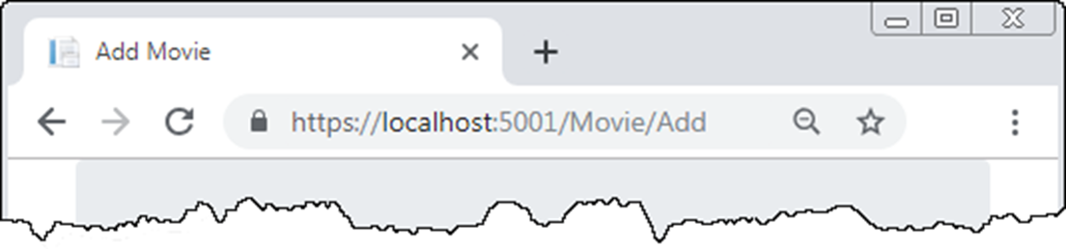
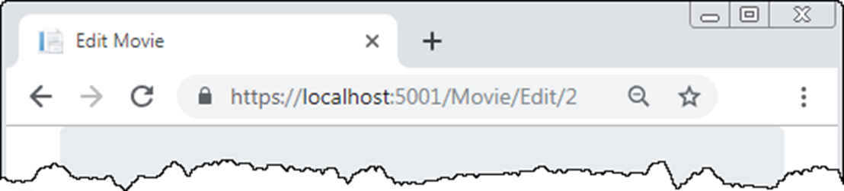
The default URLs of an MVC app

Slide 59
The ConfigureServices() method to make URLs lowercase with a trailing slash
public void ConfigureServices(IServiceCollection services) {
...
services.AddRouting(options => {
options.LowercaseUrls = true;
options.AppendTrailingSlash = true;
});
...
}

Slide 60
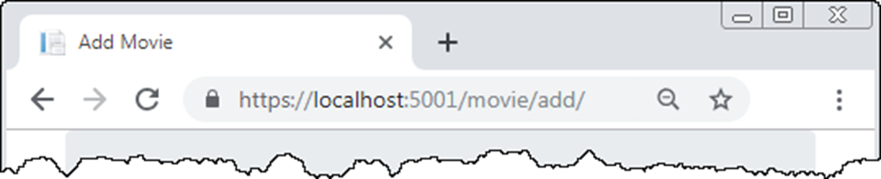
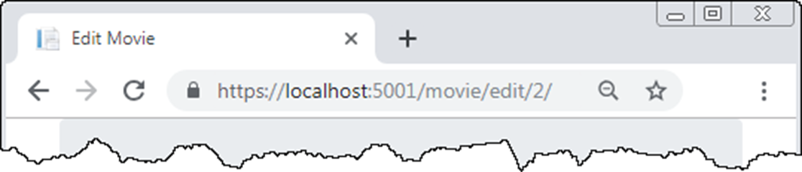
The reconfigured URLs

Slide 61
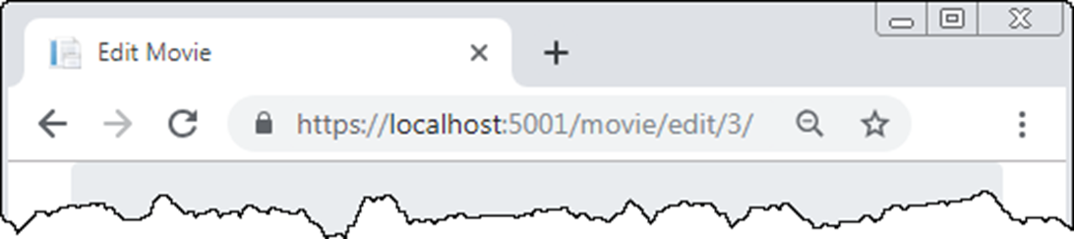
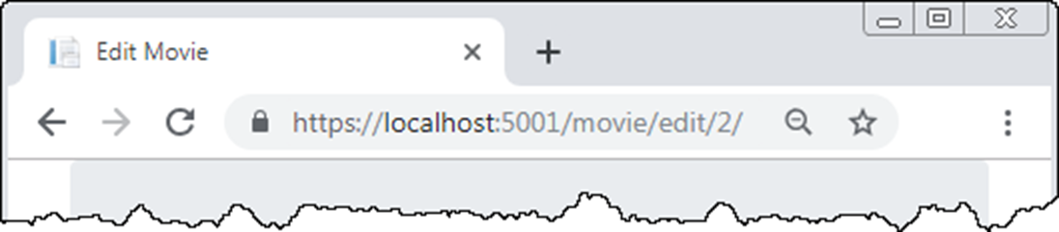
The Edit page with numeric ID values only in the URL

Slide 62
The default route updated to include a second optional parameter
app.UseEndpoints(endpoints =>
{
endpoints.MapControllerRoute(
name: "default",
pattern: "{controller=Home}/{action=Index}/{id?}/{slug?}");
});
A read-only property named Slug in the Movie class
public string Slug =>
Name?.Replace(' ', '-').ToLower() + '-' +
Year?.ToString();

Slide 63
The Edit/Delete links in the Home/Index view
<a asp-controller="Movie" asp-action="Edit"
asp-route-id="@movie.MovieId"
asp-route-slug="@movie.Slug">Edit</a>
<a asp-controller="Movie" asp-action="Delete"
asp-route-id="@movie.MovieId"
asp-route-slug="@movie.Slug">Delete</a>

Slide 64
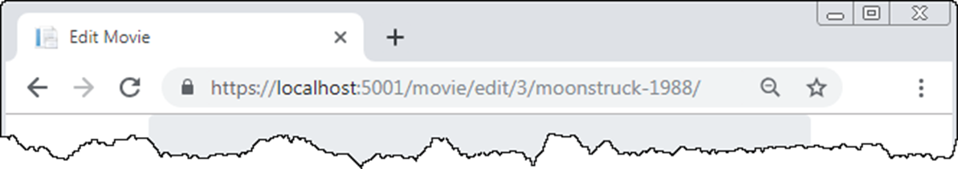
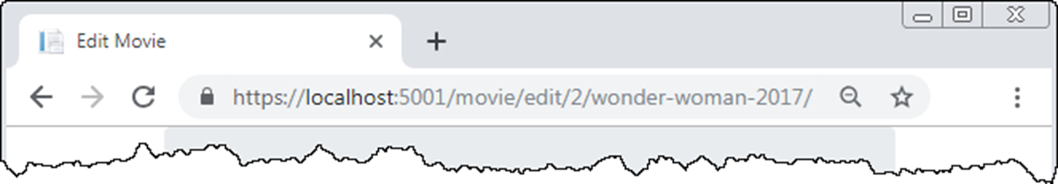
The Edit page with a slug in the URL

